Slide 1


CONSULTING
EXPERIENCE
PROJECT
Task-1
Company and Industry Analysis
Jio Mart

Slide 2
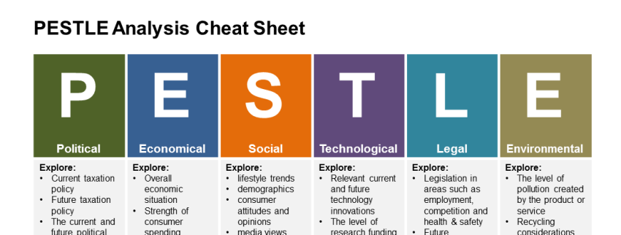
Political
Strong democracy with a strong government.
Despite efforts towards globalization, India still experiences some degree of protectionism, which is good for a home player to grow like Jio Mart.
Announcement of various initiatives like Digital India, promoting cashless economy will help Jio Mart to grow.
RBI allowed interoperability among prepaid payment instruments such as digital wallets, prepaid cash coupons, etc. greatly access customers by giving discounts.
Economic
Type your points here…

Slide 3
Social
Demographics in terms of population, growth, and urbanization present a very favorable market.
An increase in women's employment directly affects the growth of the E grocery market.
With very little time to spend with family, convenient and free home delivery became a key factor.
Security and Privacy while doing transactions remain a significant impediment for growth.
Technological
Type your points here…

Slide 4
LEGAL
ENVIRONMENT
The government working on the possibility to set up a regulatory authority to resolve disputes between large online retailers and small enterprises in the country will help in smoothing the vendor ecosystem in the company
Government new policy imposing ban on e-commerce firms from influencing pricing, employing unfair promotional activities, as well as misrepresenting the quality or features of their product offering may affect the continuous growth of the company
E-commerce players will also be compelled to store generated data on servers in India. This would put an additional burden on the firm
Type your points here…

Slide 5
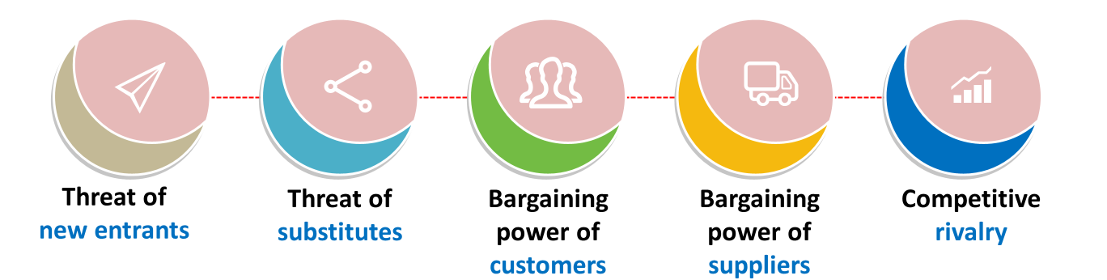
Very High
High
-- Capital requirement is less for the hyper local model.
-- Barriers of entry is less for E- Grocery store.
-- Established companies(Future Group, Big Basket, Gofers, etc) can easily take over the market share.
--With the technology growth, more people have access to internet and smartphones.
--In accordance with better discounts and offers, customers can switch between different online stores or offline stores.

Slide 7
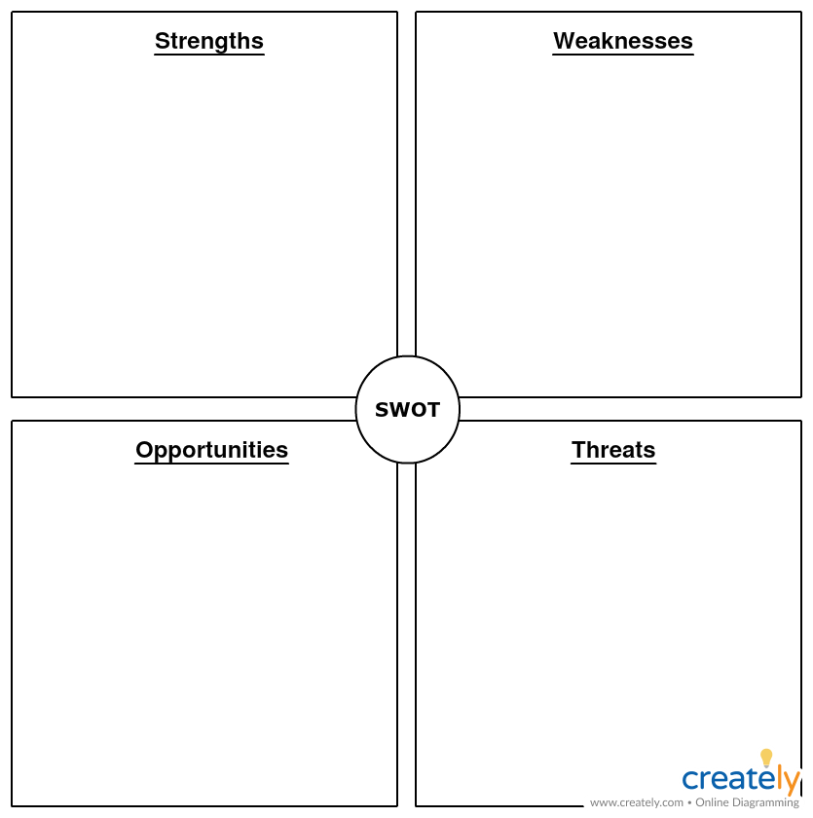
Aggregates millions of small merchants to form a pan-India supply chain through WhatsApp messenger integration with Jio
Low-cost procurement (bulk buying)
Global investments from big players like Facebook and Google .
Consumer centric and friendly business model: No questions asked return policy, no minimum order policy, big discounts etc.
Type your points here…
Type your points here….
The industry still presents enticing entry opportunities, especially the ecommerce giants out there.
Low Trust margin, buffer of error will be minimum, since consumers have ample of options to shift to.
Niche-focussed e-commerce players with custom models for specific product categories (dairy, produce)

